Slide 1


FIRE DETECTION WITH
SURVEILLANCE CAMERA USING
OPEN SOURCE COMPUTER VISION
GUIDED BY:
Mrs.B.K.HEMALATHA
HOD (i/c) ECE
KLNCIT
PRESENTED BY:
JEYA NANDHINI.J (910719104013)
PRIYA LAKSHMI.I. (910719104019)
SURYA PRAKASH.K. (910719104028)
VARSHA.M.V (910719104030)
FINAL YEAR (CSE)
K.L.N.C.I.T.
K.L.N.C.I.T/CSE
17-05-2023
Viva vice

Slide 2
OVERVIEW
Objective
Abstract
Introduction
Literature Survey
Existing System
Proposed System
Block diagram
Hardware/Software Requirements
Performance Metrics
Results
Comparison Table
Advantages
Conclusion
References
Viva vice
17-05-2023

Slide 3
OBJECTIVE
The main objective of this system is to identify the fire accidents using Deep learning and gives an alert SMS to fire station and control room.
This system also gives an warning along with buzzer alert.
K.L.N.C.I.T/CSE
17-05-2023
Viva vice

Slide 4
ABSTRACT
An automatic fire alarm system is designed to detect the presence of fire by monitoring environmental changes using surveillance camera.
The proposed system uses Deep learning and Yolo technology to detect the fire and OpenCV technology to capture the images.
The fire is detected by using surveillance CCTV camera in this existing single system and there is no need for alternative.
So the cost is cheap.
K.L.N.C.I.T/CSE
17-05-2023
Viva vice

Slide 5
INTRODUCTION
Nowadays,Fire is the major cause of death in residents due to lack of automation and emergency alert systems.
The main source of fire in residents is due to burning of materials,flammable gases,electric circuits,etc.
Fire Alarm are very common in commercial buildings and factories.
We detect fire using CCTV camera itself and there is no need of sensors.
K.L.N.C.I.T/CSE
17-05-2023
Viva vice

Slide 6
LITERATURE SURVEY
S.NO | TITLE OF THE PAPER and Name of the journal | AUTHORS/ YEAR | ALGORITHM/ METHOD | INFERENCE
1. | Forest-Fire Response System Using Deep-Learning-Based Approaches with CCTV Images and Weather Data(IEEE Transaction on The National Research Foundation of Korea through the ministry of science.) | Dai Quoc Tran,Minsoo Park,Yuntae Jeon and Seunghee Park | BNN(Bayesian Neural Network),Detnas | Immediate action and prevent from the major cause
K.L.N.C.I.T/CSE
17-05-2023
Viva vice

Slide 7
LITERATURE SURVEY
S.NO | TITLE OF THE PAPER and Name of the journal | AUTHORS/ YEAR | ALGORITHM/ METHOD | INFERENCE
2. | “IoT-Based Fire Alarm System,” in 2019 Third World Conference on Smart Trends in Systems Security and Sustainability (Third World Conference on Smart Trends in System Security and Sustainability.). | A.Mahgoub,N.Tarrant, R. Elsherif, A. Al-Ali, and L. Ismail, (2019) | open cv | Quality and visibility of local details are better
Viva vice
17-05-2023
K.L.N.C.I.T/CSE

Slide 8
LITERATURE SURVEY
S.NO | TITLE OF THE PAPER and Name of the journal | AUTHORS/ YEAR | ALGORITHM/ METHOD | INFERENCE
3. | Towards a Smart Elevator-Aided Fire Evacuation Scheme in High-Rise Apartment Buildings for Elderly | Hongqiang Fang,Hongpeng Qiu,Peng Lin,S.M. Lo,J.T.Y.Lo | SEABFE | the fire situation and evacuation progress might alter over time, the optimal EAE strategy can be determined repeatedly, allowing for the real-time modification of EAE strategies.
Viva vice
17-05-2023
K.L.N.C.I.T/CSE

Slide 9
EXISTING SYSTEM
This existing system shows that an effective forest-fire response is critical for minimising the losses caused by forest fires.
The motto is to construct a model for early fire detection based on deep learning.
K.L.N.C.I.T/CSE
17-05-2023
Viva vice

Slide 10
EXISTING SYSTEM
Neural architecture search-based object detection (DetNAS) is used for searching optimal backbone networks in the application of deep learning-based models.
A large scale fire dataset(approximately 400,000)images is used to train and test object-detection models with well-known backbones such as ResNet, VoVNet, and FBNetV3.
K.L.N.C.I.T/CSE
17-05-2023
Viva vice

Slide 11
EXISTING SYSTEM
We propose a damage area estimation method using Bayesian neural network (BNN)model.
Faster RCNN object detection architecture is used and is composed of three parts
1. Convolution layers
2. Region Proposal Network (RPN)
3. Classes and Bounding Boxes prediction.
K.L.N.C.I.T/CSE
17-05-2023
Viva vice

Slide 12
PROBLEM DEFINITION
The Existing fire detection systems is Sensitive to dust particles and insects, meaning that regular maintenance is needed.
It requires more power and more maintenance cost.
K.L.N.C.I.T/CSE
17-05-2023
Viva vice

Slide 13
PROPOSED SOLUTION
In the Proposed System we have utilized the advancements, we use opencv and YOLO V5 algorithm.
The proposed solution will include the subsystem that detects the fire and alert automatically incase fire detected.Through that,the proposed system will give the high opportunity of taking action when fire outbreaks.
K.L.N.C.I.T/CSE
Viva vice
17-05-2023

Slide 14
BLOCK DIAGRAM
INPUT(CAMERA)
VIDEO
PRE-PROCEESSING AND TRAINING
MACHINE LEARNING MODEL
PREDICTION
IF FIRE OCCURS
NO
YES
TRIGGER ALARM AND SENDS MESSSAGE
NOTIFY TO WORKER(ADMIN),CONTROL ROOM AND FIRE STATION
K.L.N.C.I.T/CSE
17-05-2023
Viva vice

Slide 15
EXPLANATION
OpenCV is a python package for creating real-time computer vision applications. Image and video processing and analysis are handled by the OpenCV library.
The YOLO V5 algorithm is a single object detector combined bounding box prediction and object classification into a single end to end differentiable network.
Fire is detected by the YOLO V5 algorithm, while computer vision is handled by the OpenCV library.
Alarm is activated when the fire is detected and the alert message is generated to respective admin.
K.L.N.C.I.T/CSE
17-05-2023
Viva vice

Slide 16
MODULES
Opencv Module
Yolo Algorithm Module
Alarm Notification Module
K.L.N.C.I.T/CSE
17-05-2023
Viva vice

Slide 17
OPEN -CV MODULE
OpenCV is the huge open-source library for computer vision, machine learning,image processing and a major role in real-time operation.
It processes images and videos to identify objects, faces, or even handwriting of a human.
NumPy, python is capable of processing the OpenCV array structure for analysis.
K.L.N.C.I.T/CSE
17-05-2023
Viva vice

Slide 18
YOLO ALGORITHM MODULE
YOLO(You Only Look Once) is an algorithm that detects and recognizes various objects in real-time.
Object detection in YOLO is done as a regression problem and provides the class probabilities of the detected images.
the algorithm requires only a single forward propagation through a neural network to detect objects.
The architecture of the CNN model that forms the backbone of YOLO.
K.L.N.C.I.T/CSE
17-05-2023
Viva vice

Slide 19
ALARM NOTIFICATION MODULE
The playsound module is a cross platform module that can play audio files and implement on platforms.
It works with both WAV and MP3 files.
Twilio is a customer engagement platform used by thousands of businesses and more than ten million developers worldwide to build unique, personalised experiences for their customers.
K.L.N.C.I.T/CSE
17-05-2023
Viva vice

Slide 20
SOFTWARE/HARDWARE REQUIREMENTS
Software Requirement:
Python 3.10
Anaconda Navigator
Jupyter notebook
VS code
K.L.N.C.I.T/CSE
Viva vice
17-05-2023

Slide 21
Hardware Requirement:
System : Windows 10
Processor : 2.20 GHz
Memory : 200 GB RAM
K.L.N.C.I.T/CSE.
17-05-2023
Viva vice

Slide 22
PERFORMANCE METRICS
FPS(Frames Per Second)
Recall
Precision
mAP(Mean Average Precision)
K.L.N.C.I.T/CSE
Viva vice
17-05-2023

Slide 23
FORMULA USED
FPS (Frames Per Second):
FPS = 1 / time per frame
Recall:
Recall = true positives / (true positives + false negatives)
Precision:
Precision = true positives / (true positives + false positives)
mAP (Mean Average Precision):
mAP = 1/Number * sum(i=1 to N) AP_i
K.L.N.C.I.T/CSE
Viva vice
17-05-2023

Slide 24
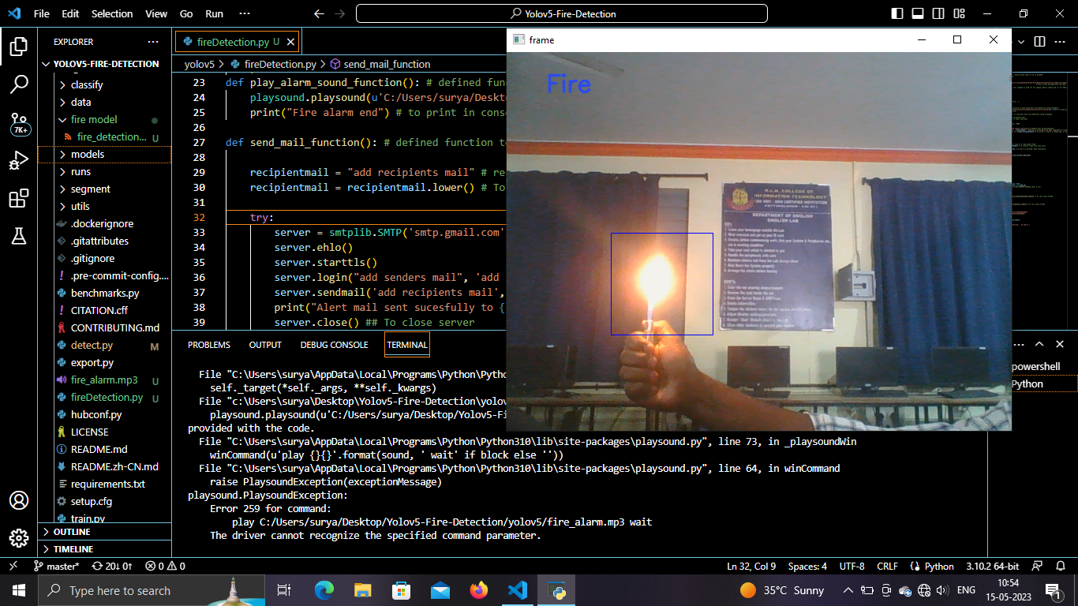
Screenshot of Result-1
.
K.L.N.C.I.T/CSE.
17-05-2023
Viva vice
24

Slide 25
EXPLANATION
The primary function of this system is to detect fires and turn on alarms to warn of fire accidents.
Using OpenCV , we can access the camera and get a live video streaming.
It converts the video into frames and compares the Frame with the trained model using YOLO.
K.L.N.C.I.T/CSE.
17-05-2023
Viva vice

Slide 26
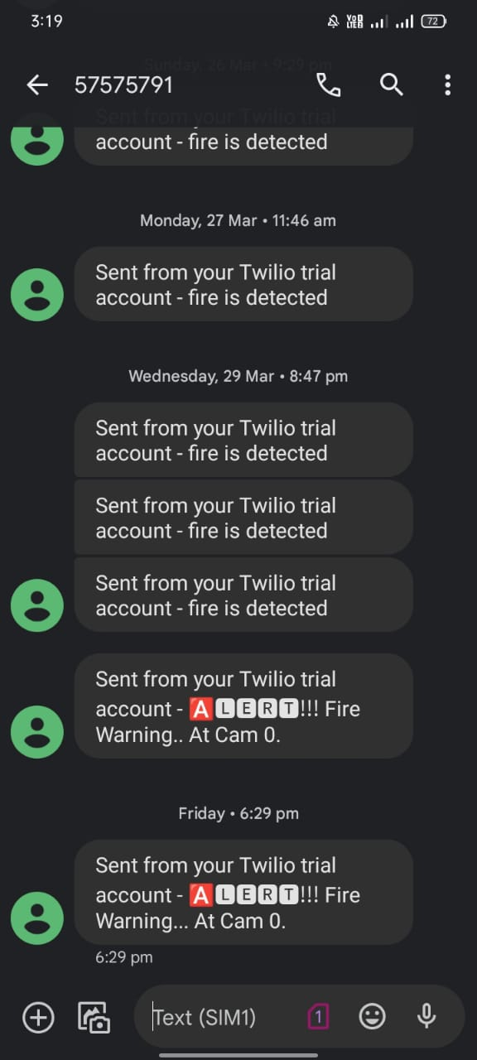
Screenshot of Result-2
.
17-05-2023
K.L.N.C.I.T/CSE.
Viva vice

Slide 27
EXPLANATION
The primary motivation for this system is to provide early notification to Employees, Students and Peoples.
So, they can exit the building, and to notify the fire service so it can respond to the Fire.
K.L.N.C.I.T/CSE.
17-05-2023
Viva vice

Slide 28
COMPARISON TABLE
Algorithm | mAP | Precision | Recall | FPS
YOLO v5 | 0.5 | 0.900 | 0.500 | 170
YOLO v4 | 0.43 | 0.886 | 0.423 | 63
Faster R-CNN | 0.42 | - | - | 25
RetinaNet | 0.39 | 0.800 | 0.383 | 33
SSD | 0.33 | 0.782 | 0.329 | 46
K.L.N.C.I.T/CSE.
17-05-2023
Viva vice

Slide 29
ADVANTAGES
Open -cv is used instead of sensors which is good in accuracy.
Setup cost is cheap.
Accuracy is high.
24/7 increased protection from fire
Reduce business disruption.
Viva vice
17-05-2023
K.L.N.C.I.T/CSE

Slide 30
CONCLUSION
Inspired by the great potential of Yolos, we can detect fire from images or videos at an early stage.
This project proposed a fire detection algorithm which is free from sensors as the ordinary fire detection systems contain.
Based on the results produced, the system has proven to be effective at detecting fire.
Viva vice
17-05-2023
K.L.N.C.I.T/CSE

Slide 31
APPENDIX
PUBLICATION DETAILS
We (J.JEYANANDHINI, I.PRIYALAKSHMI, K.SURYAPRAKASH, M.V.VARSHA) of K.L.N COLLEGE OF INFORMATION TECHNOLOGY presented the paper entitled “FIRE DETECTION WITH SURVEILLANCE CAMERA USING OPEN SOURCE COMPUTER VISION” in One Day Virtual National Conference on “NATIONAL CONFERENCE ON RECENT TECHNOLOGIES AND COMPUTING SCIENCES-NCRTCS 23” organised by “Department of information technology-VELAMMAL ENGINEERING COLLEGE (An Autonomous Institution)” on 11th April 2023.
Viva vice
17-05-2023
K.L.N.C.I.T/CSE

Slide 32
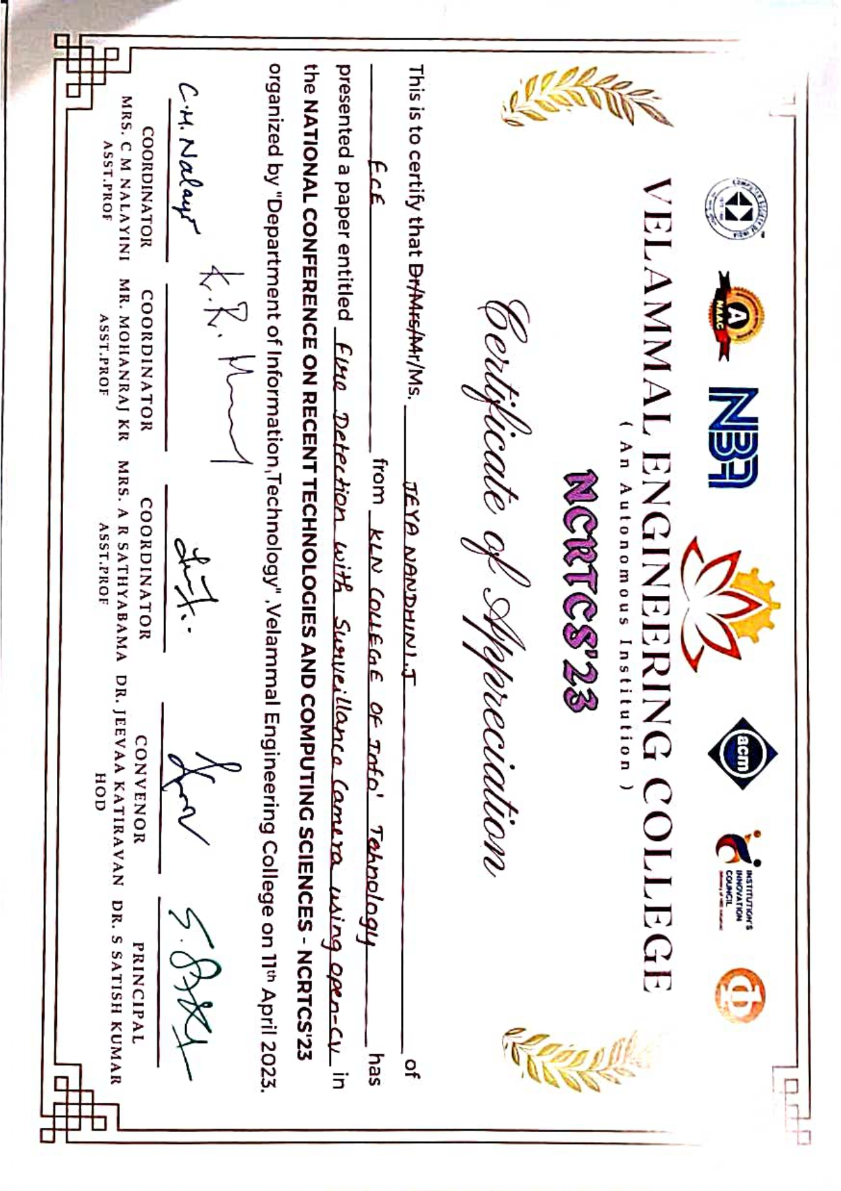
Viva vice
17-05-2023
K.L.N.C.I.T/CSE

Slide 33
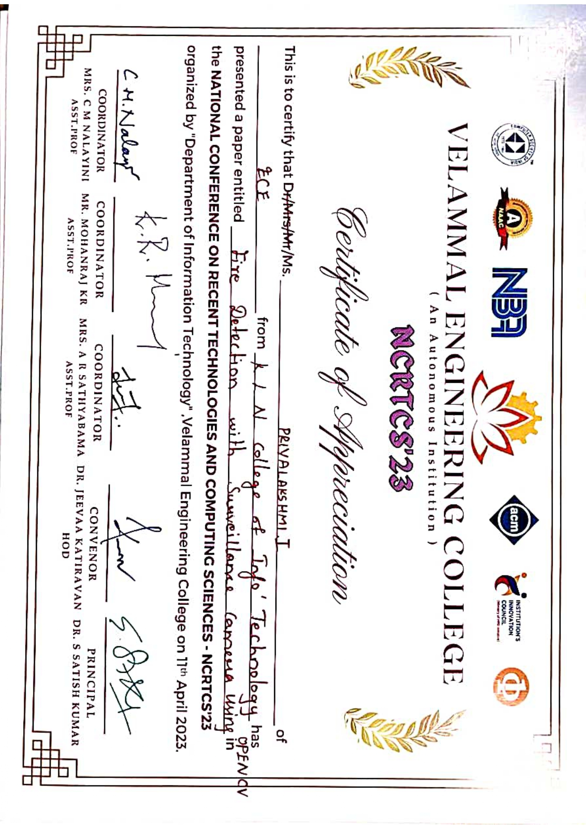
Viva vice
17-05-2023
K.L.N.C.I.T/CSE

Slide 34
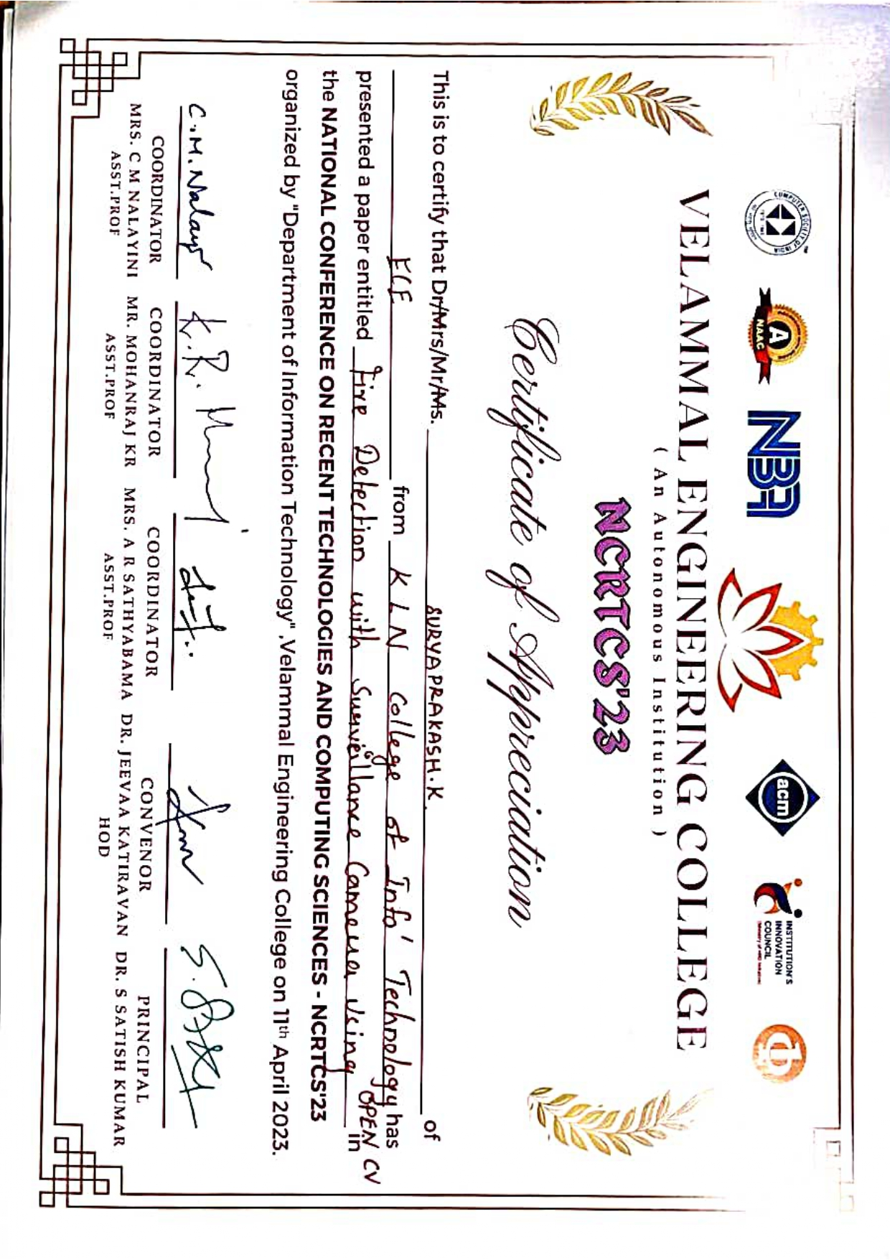
Viva vice
17-05-2023
K.L.N.C.I.T/CSE

Slide 35
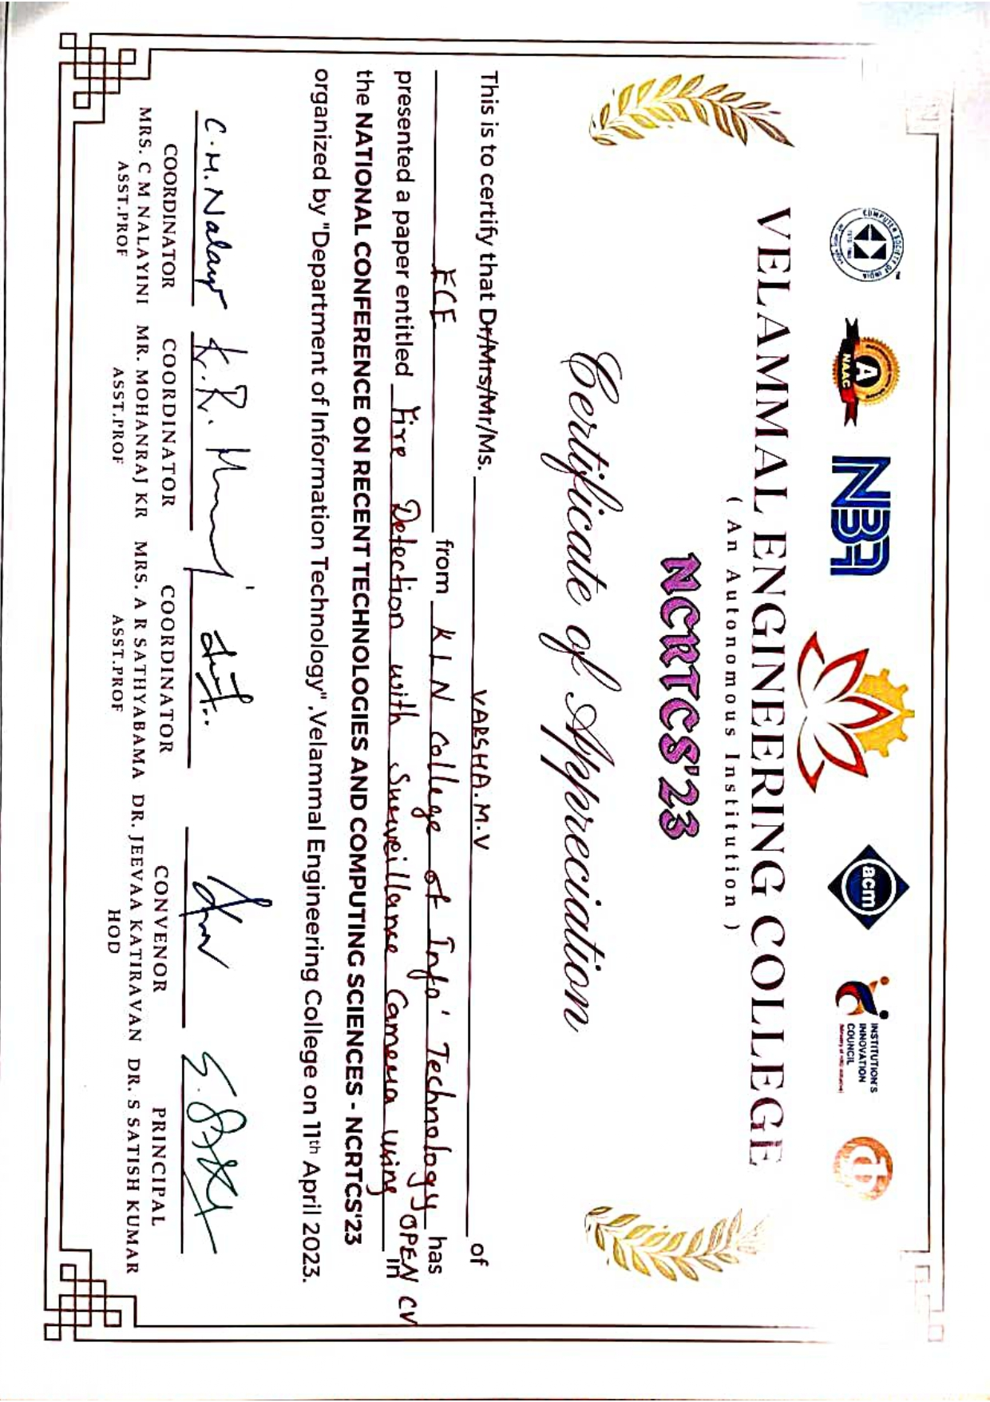
Viva vice
17-05-2023
K.L.N.C.I.T/CSE

Slide 36
REFERENCES
F. Gong and C. Li, "A Real-Time Fire Detection Method from Video with Multi feature fusion".
M. M.-R. MANISH BHATTARAI, "A Deep Learning Framework for Detection of Targets in Thermal".
M. Khan, S. Khan, M. Elhoseny, S. H. Ahmed and S. W. Baik, "Efficient Fire Detection for Uncertain Surveillance Environment".
M. Khan, J. Ahmad and Sung Wook Baik, "Early fire detection using convolutional neural networks during surveillance for effective disaster management".
Viva vice
17-05-2023
K.L.N.C.I.T/CSE

Slide 37
Thank you
Viva vice
17-05-2023
K.L.N.C.I.T/CSE

